Slide 1
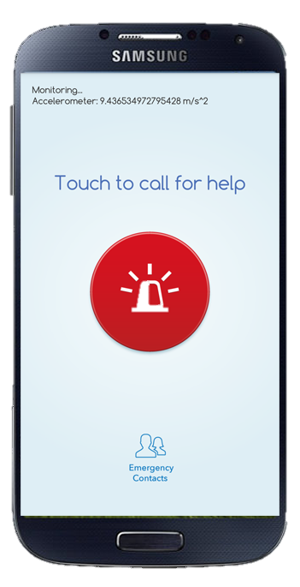
By Lim Soon Heng

Slide 2
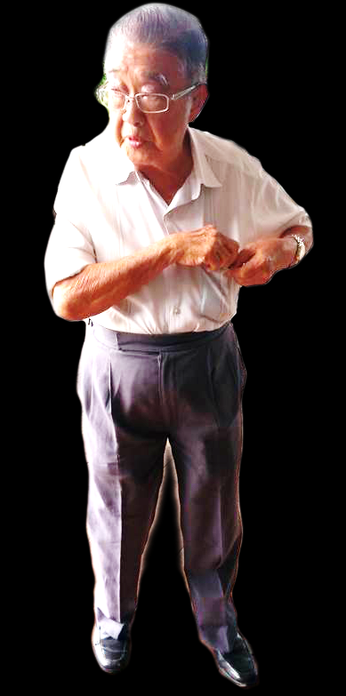
My anxiety
My inspiration
My first user

Slide 3
765 MILLION
60+
1.4 BILLION
2030
255 MILLION

Slide 4
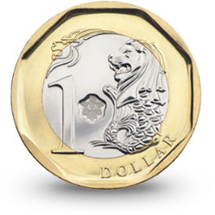
TIMELY response
AFFORDABLE monitoring

Slide 5
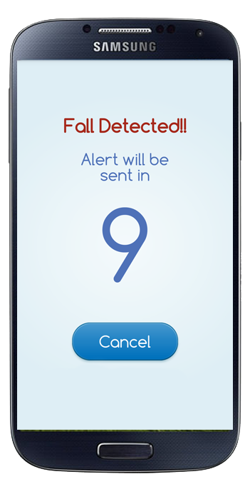
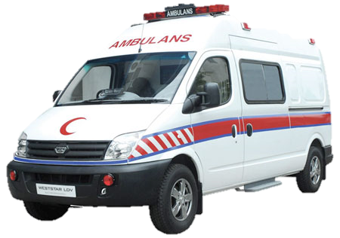
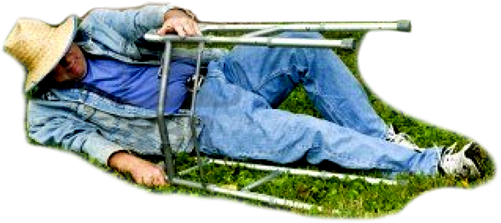

Slide 6
Marketing
legal
Call centre
telco
ipr
Business analytics
Senior citizen networks
Home security
universities

Slide 7
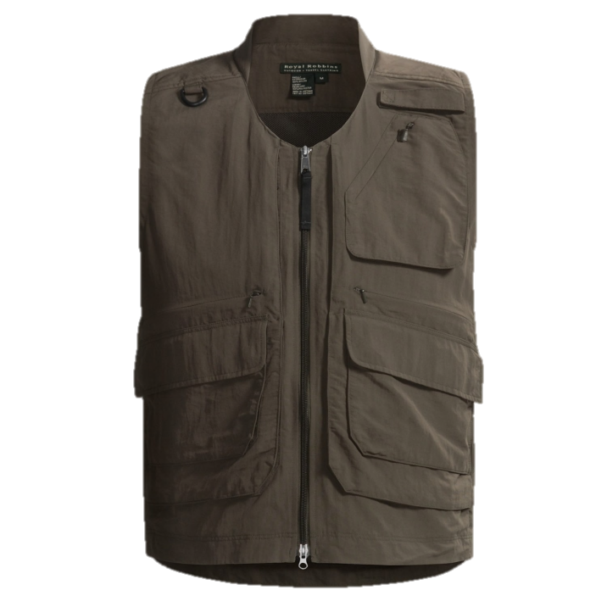
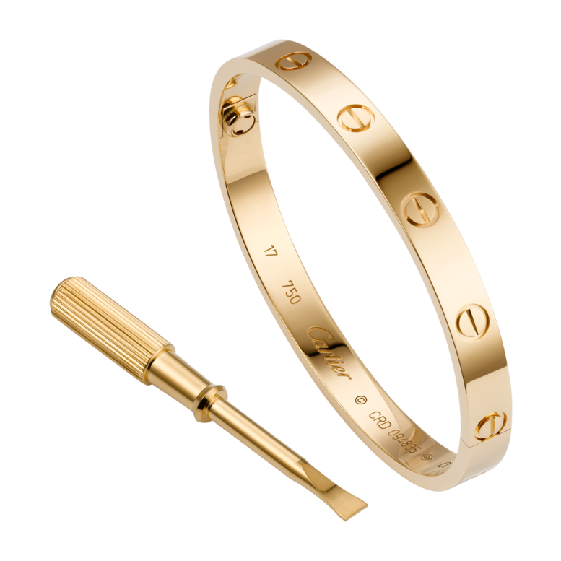
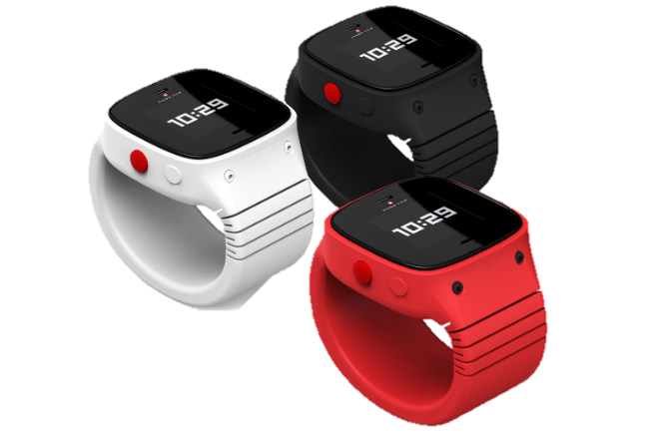
the INFINITE FUTURE of GUARDIAN ANGEL
WEARABLE TECH

