Slide 2
Hi

Slide 3
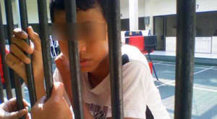
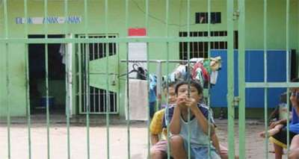
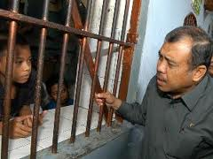
FACT #1
IN KEDIRI , EAST JAVA 50% OF YOUTH CRIMINAL CASE COME FROM MIGRANT WORKERS FAMILY

Slide 4
FACT #2
IN JEMBER , EAST JAVA 60% OF DIVORCE CASE COME FROM MIGRANT WORKERS FAMILY

Slide 5
1.600 $
400 $
100 $

Slide 7
PROBLEMS
1. LACK OF INFORMATION
CONNECT THEM WITH PROPER JOB
2. UNDERESTIMATED
PROMOTE THEM TO EMPLOYERS

Slide 8
PROGRESS | MAY | JUN | JUL | AUG | SEP | NOV | DEC | JAN | FEB | MAR | APR | MAY
MARKET RESEARCH
ALPHA TESTING
BETA TESTING
DESIGN AND DEVELOPMENT
LAUNCHING
20

Slide 9
NOT ONLY IN INDONESIA
INDIA
PHILIPPINES
VIETNAM

Slide 11
Thank You
CONTACT US AT :
HANAN
+6281703030093
migranindonesia@GMAIL.COM

